Slide 1
Train the Trainer VVD
Evalyne Gichuki
Student
Feeds & Forage
Connected Virus & Vectors Training

Slide 2
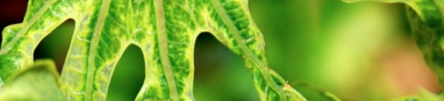
Assignment
Primer design
PCR amplification & barcoding

Slide 3
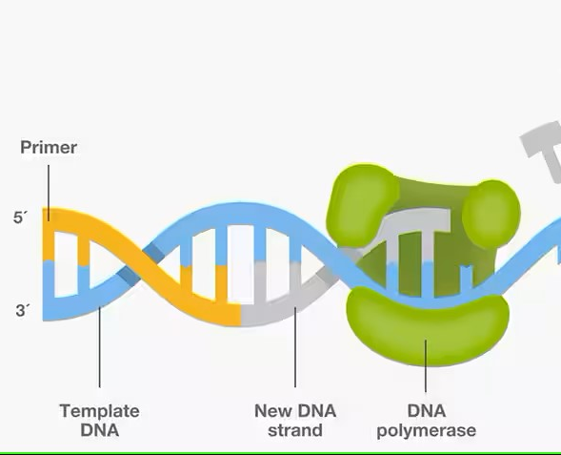
Primer design
Maintains the efficiency and specificity of the amplification reaction
Tips
GC content 40 – 60%
Avoid GC clump

Slide 4
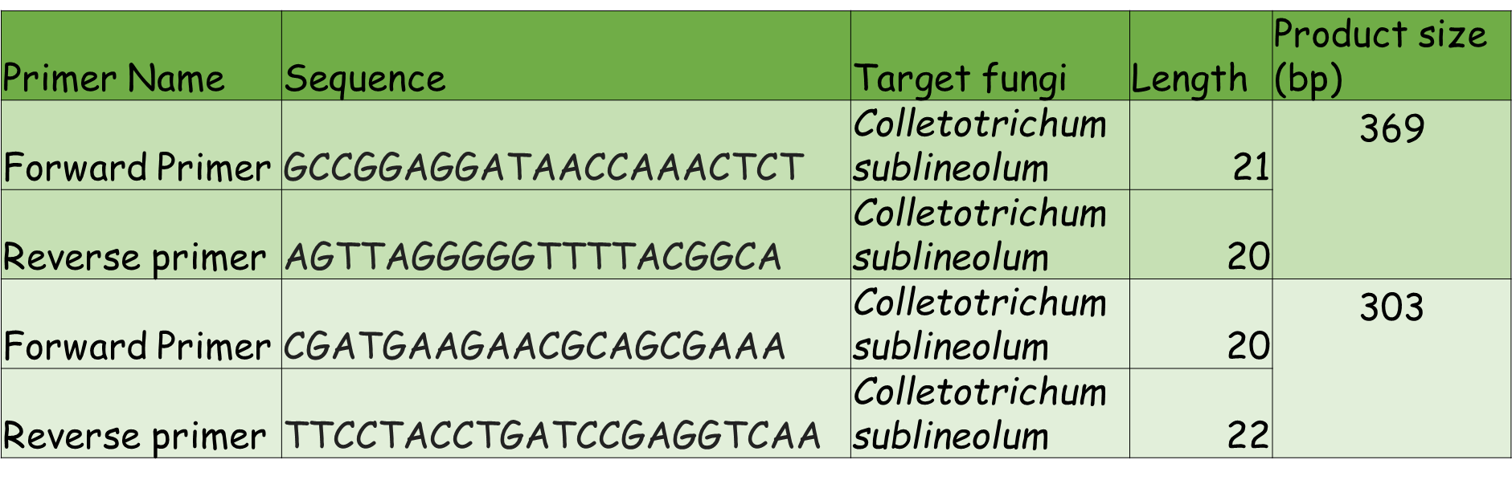
Primer Results

Slide 5
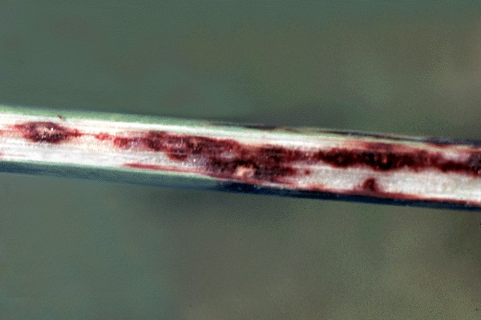
C. Sublineolum 1st primer

Slide 6
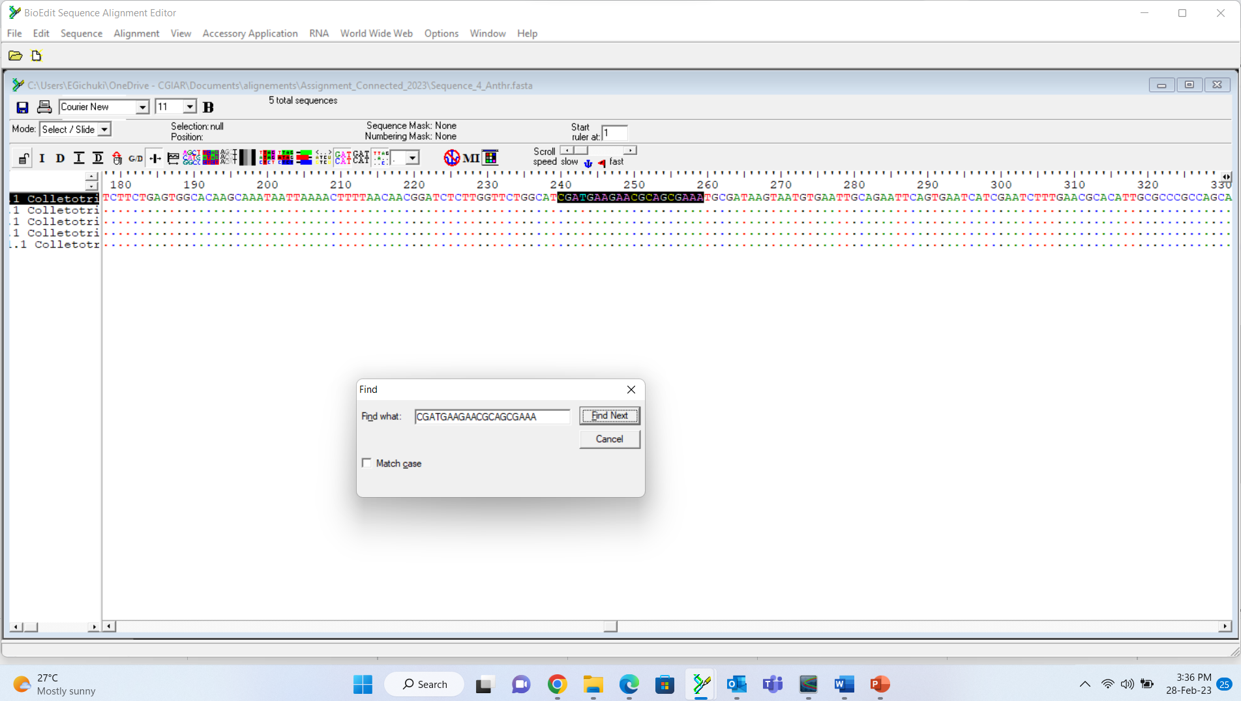
Forward Primer Alignment

Slide 7
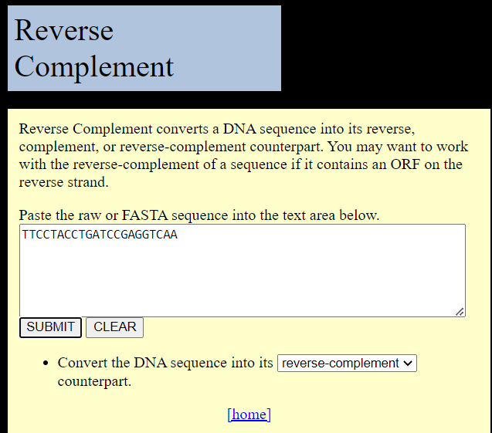
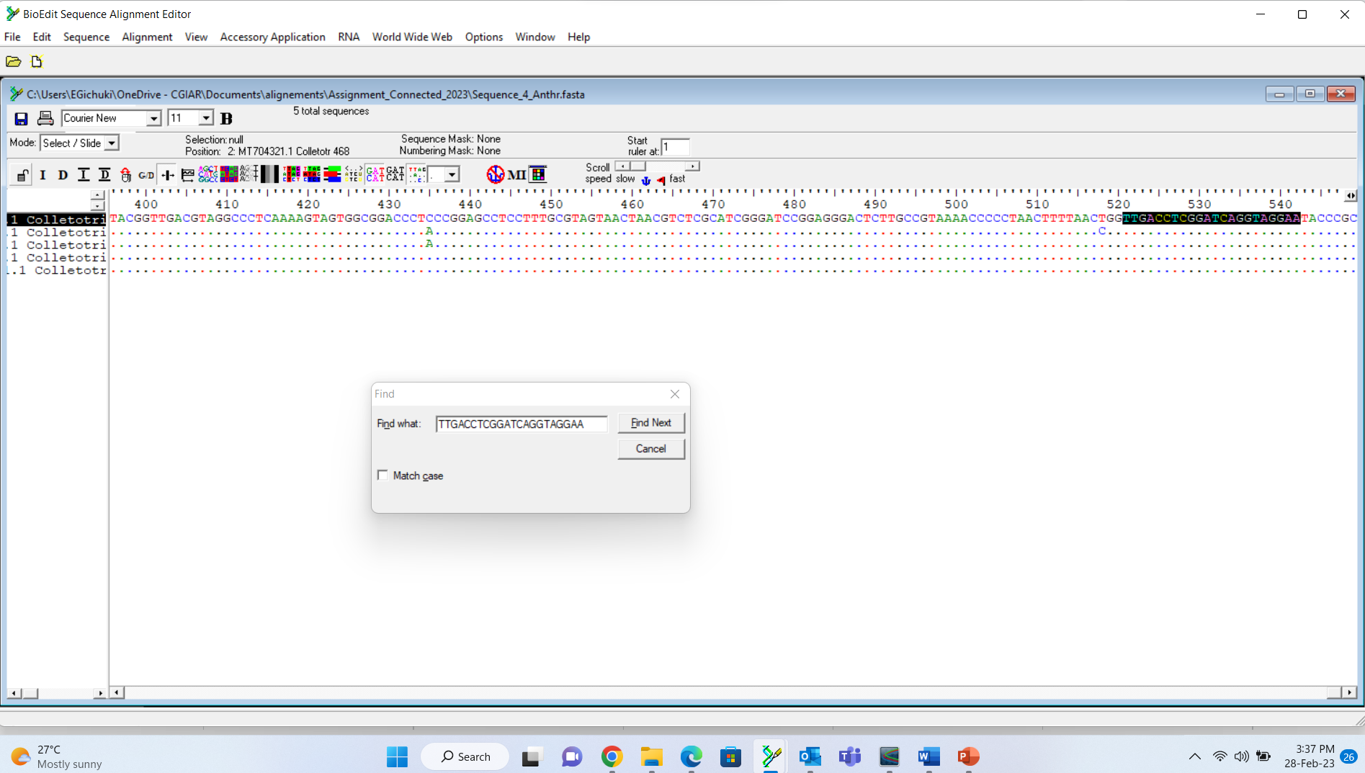
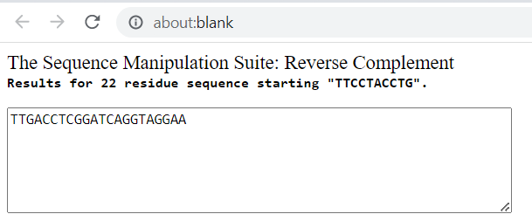
Reverse primer alignment

Slide 8

PCR Amplification & Barcoding
DNA Extraction
Dilution
PCR
Sequencing

Slide 9
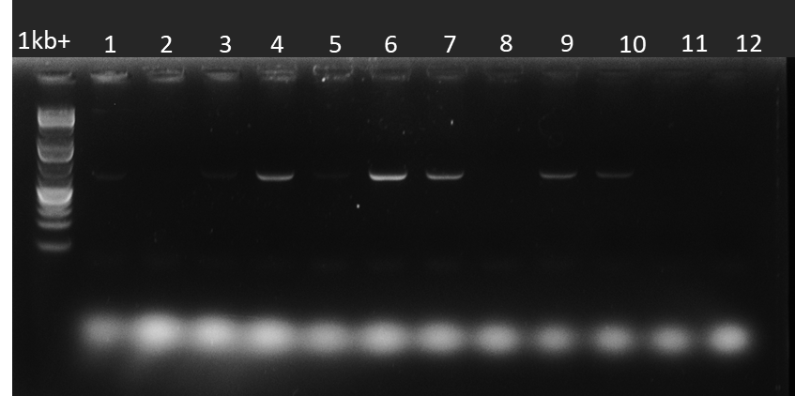
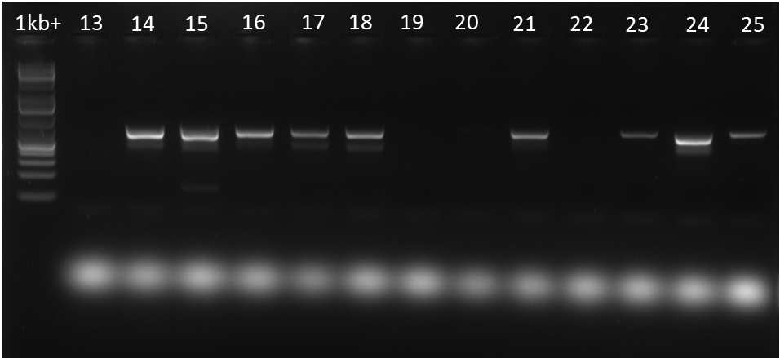
UNDILUTED DNA

Slide 10
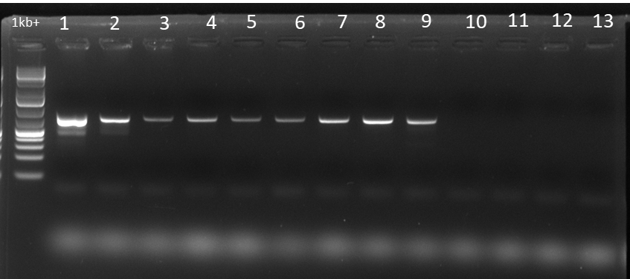
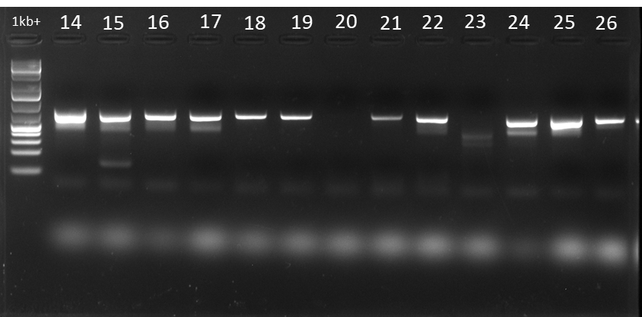
DILUTED DNA

Slide 11
TYLCV Primer Design Challenges
Primer dimers (purification issue, hybridization)
Lack of specificity of some primers

Slide 12
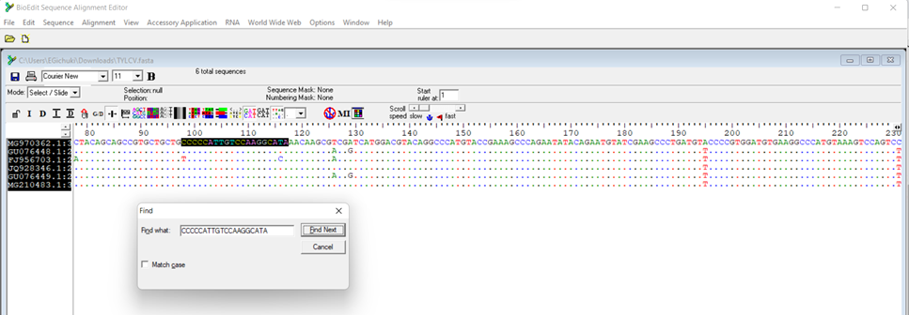

Slide 13
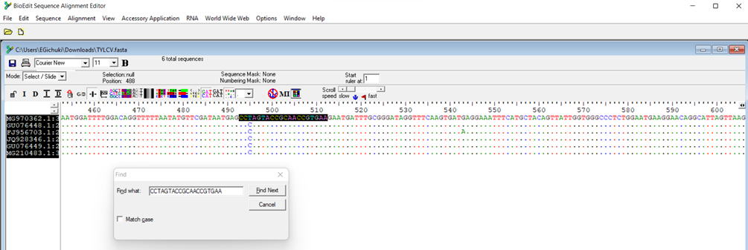

Slide 14
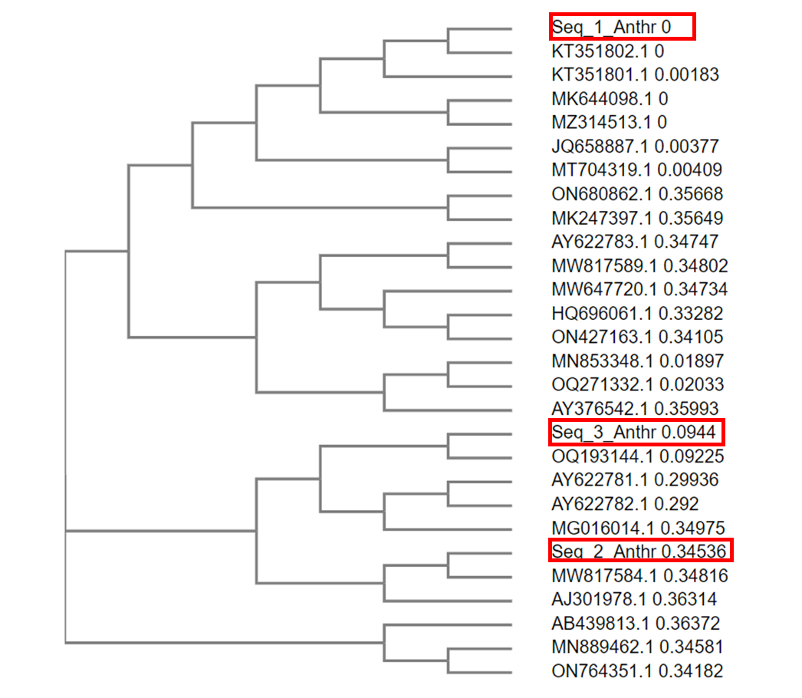
Phylogenetic tree

Slide 15
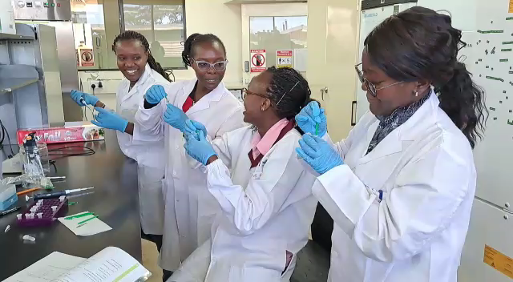
Knowledge Sharing
Influences scientific research, regulation or policymaking
Improves mastery/retains knowledge
Saves money for a company/organisation
Feel good factor

Slide 16
Thank You

